Slide 1
IKT Project - 2023
Halász Noel, Ábel Dávid Gyula

Slide 2
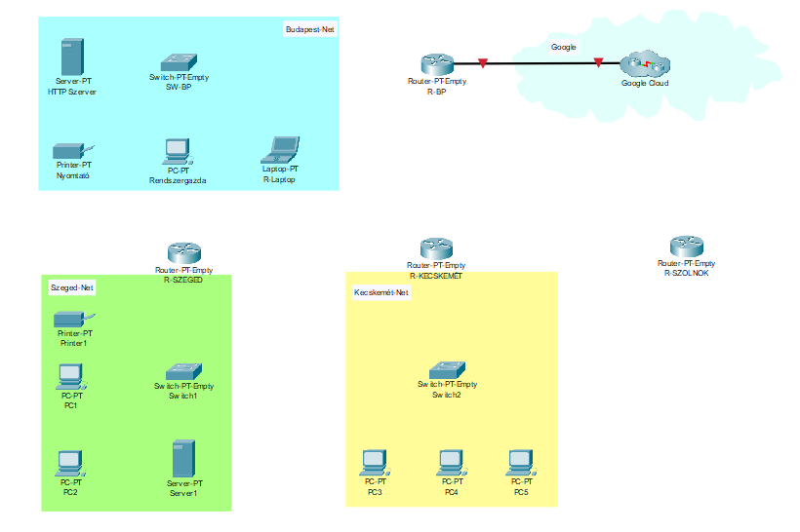
Placement and Grouping of Routers, Switches, and Digital Devices.

Slide 3
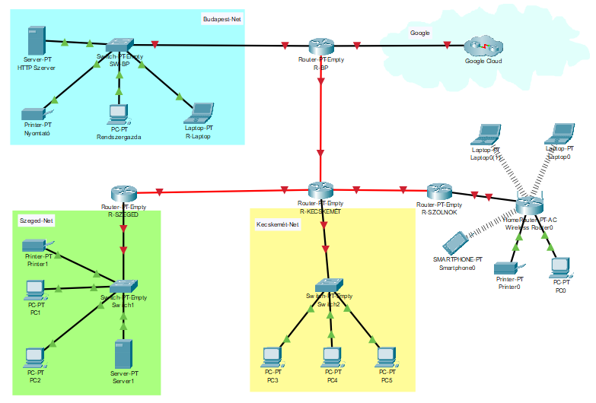
Proper Connection of the Devices.

Slide 4
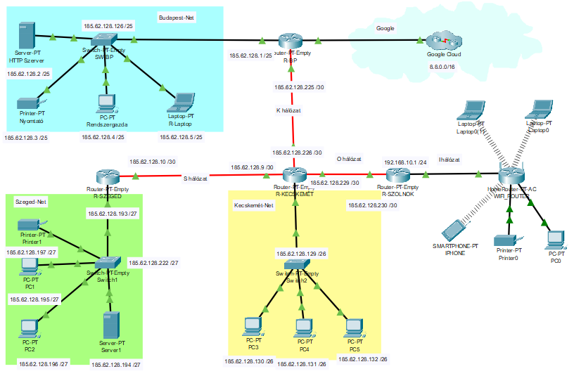
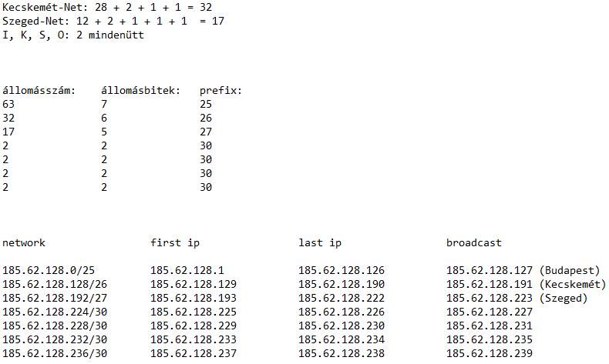
Assigning IP Addresses.

Slide 5

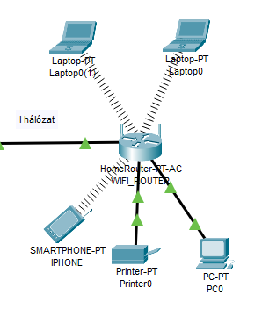
Proper Connection of Wireless Devices.

Slide 6
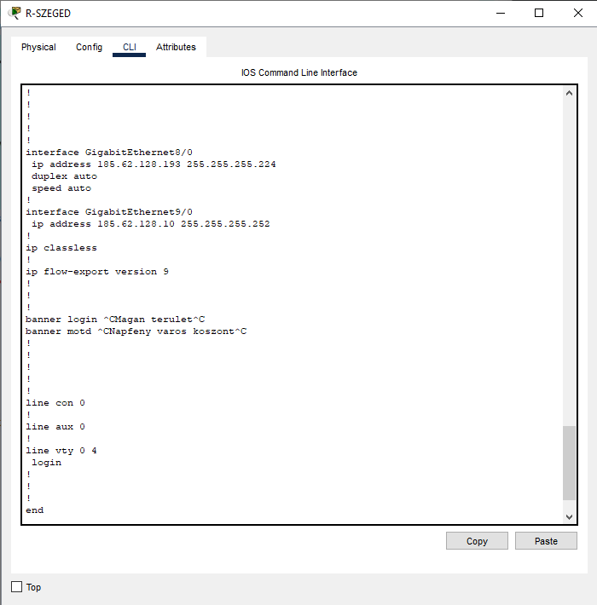
As an example: Configuring a Router.

Slide 7
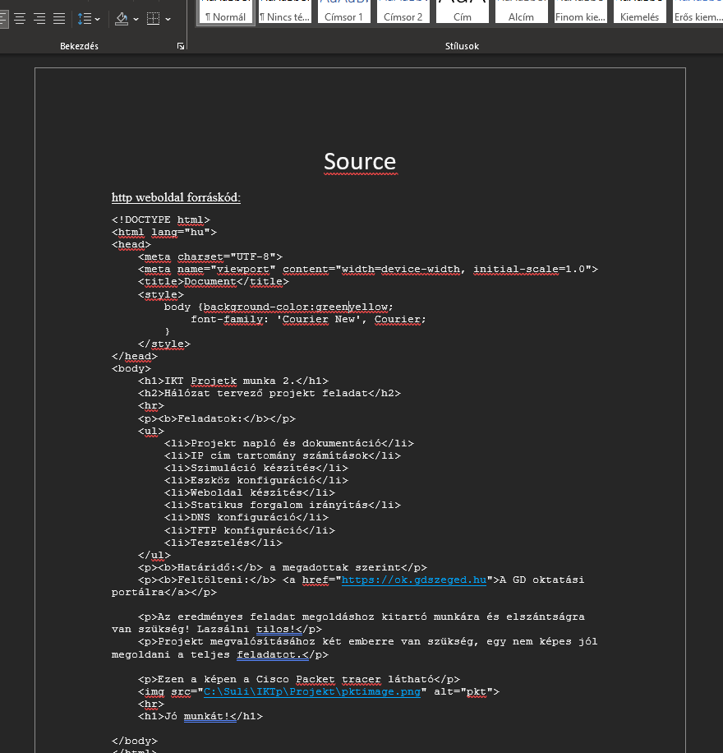
Source, program

